Slide 1


NCDOT ProjectWise and Open Roads Designer (ORD) Update
NCLUG Winter Conference
Dec 5, 2018
Presenter: Bryan Edwards, PE

Slide 2

Organizational Changes
Effective July 1, 2018
NCDOT Information Technology moved to NCDIT

Slide 3
NCDOT ProjectWise Update

Slide 4
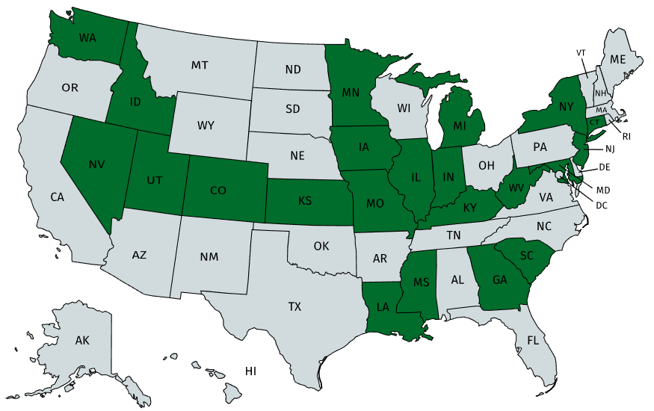
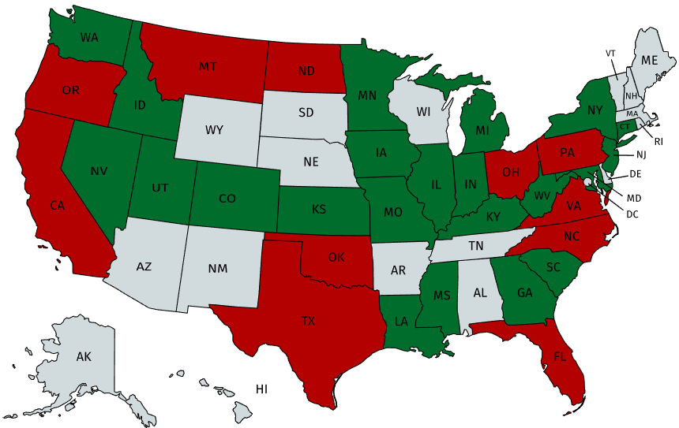
ProjectWise Use Among State DOTs

Slide 5


ProjectWise
Project Store and SharePoint
ProjectWise Benefits
External partners have controlled access to projects
True Document Management System for CADD
Collaborations Area
Search and Report
NCDOT
(ProjectStore)
NCDOT
SharePoint
(Non CADD)
ProjectWise
(CADD)
SharePoint Benefits
External partners have controlled access to projects
Document management system (for non CADD)
No cumbersome FTS/email for file delivery
NCDOT
External Partners

Slide 6
How does it work?
NCDOT ProjectWise
Access to Cloud
Managed Workspaces
Speed
Reference Files
(read only)
DGN file
(checked-out)
CADD Workspace Standards

Slide 7
How does it work?
NCDOT ProjectWise
User can check back in file or update server copy
If user leaves town without checking in file, and Admin has to force a check in .. Reverts back to status
Reference Files
(read only)
DGN file
(checked-in)
CADD Workspace Standards

Slide 8
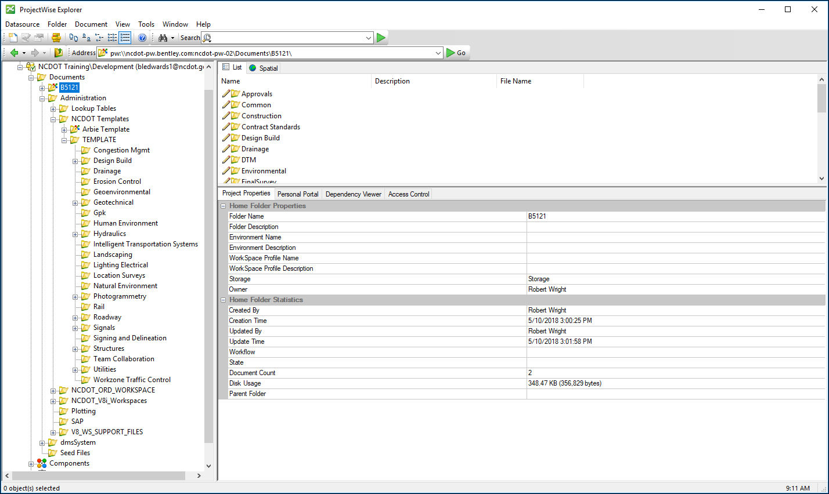
ProjectWise Explorer

Slide 9
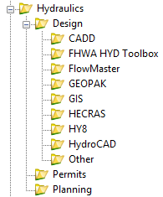
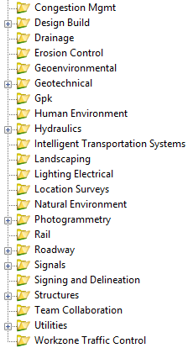
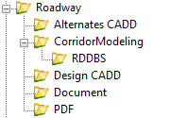

New TIP Folder Structure

Slide 10
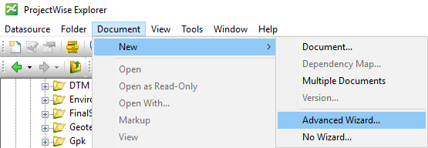
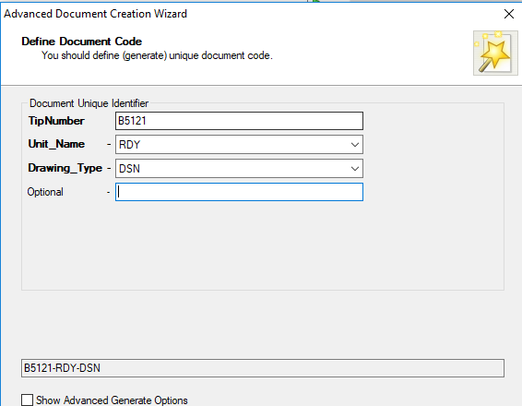
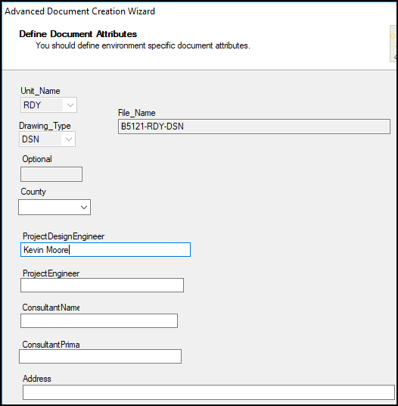
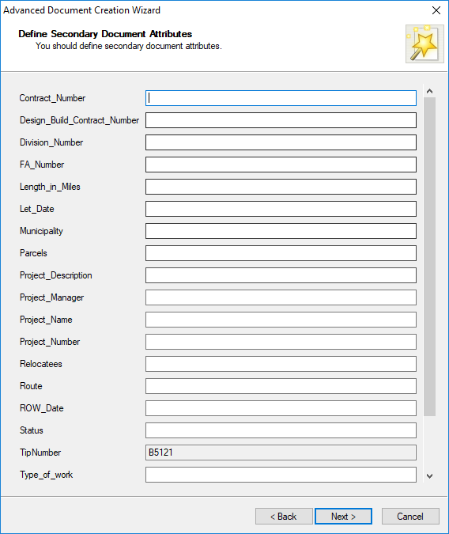
File Creation
CADD Services ProjectWise Meetings
DesignFileGenerator – Functionality Built in to ProjectWise

Slide 11
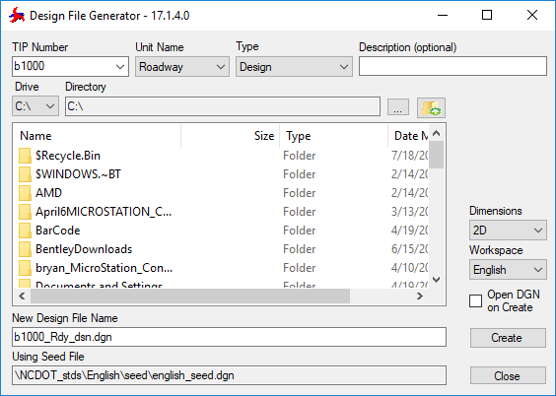
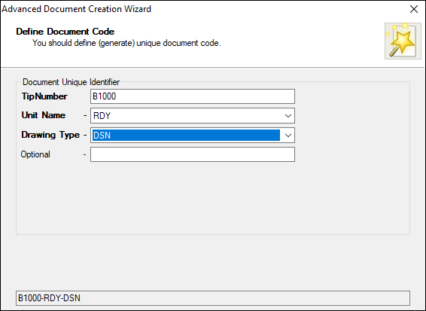
File Creation in PW - No Underscore in Filename
Design File Generator
ProjectWise Advanced Document Creation Wizard
B1000_rdy_dsn.dgn
B1000-rdy-dsn.dgn
ProjectWise can handle files with underscores just fine. However, the file generation capability of ProjectWise can not handle underscores

Slide 12
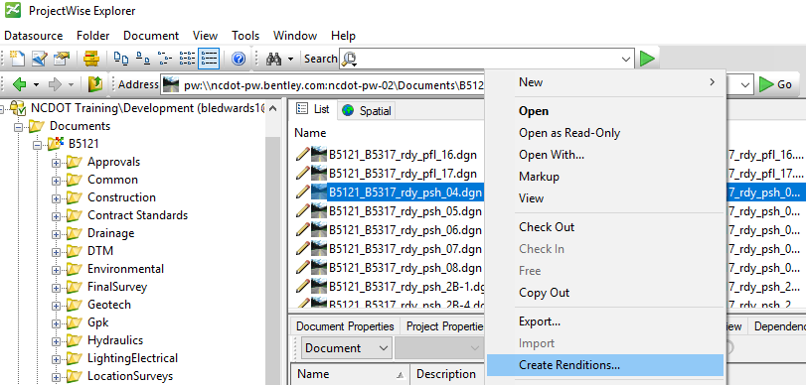
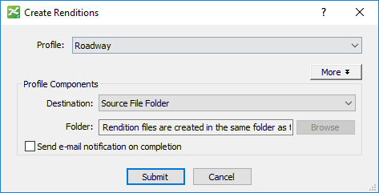
PDF Creation - Renditions
CADD Services ProjectWise Meetings

Slide 13
Metadata Attribution – From SAP

Slide 14
ProjectWise Licensing Options
Passport
($128/yr/person)
Tools
ProjectWise Web Client
Deliverables Management
(More geared for review / not ideal for collaboration)
Visa
($720/yr/person)
Tools
ProjectWise Web Client
(Ideal for collaboration / most larger firms already have this / CADD Workspaces wrapped inside)

Slide 15
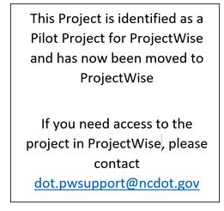
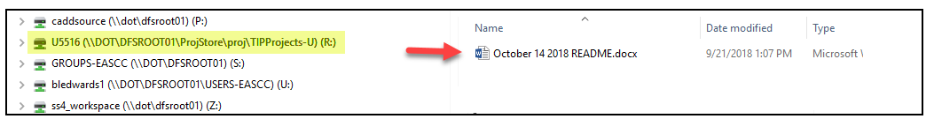
NCDOT - ProjectWise Pilots
Implemented October 29, 2018
U-5516
R-5600
R-4707
B-4937
B-5356
Div 5
Ben Upshaw
John Braxton
Div 14
Wesley Jamison
Josh Deyton
Central
Laura Sutton
Bryan Key
Structures
Kevin Fischer
Structures
Kevin Fischer

Slide 16
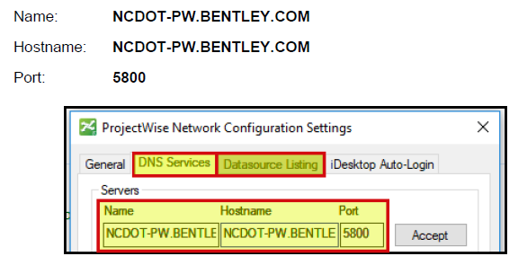
NCDOT ProjectWise Hosted by Bentley

Slide 17
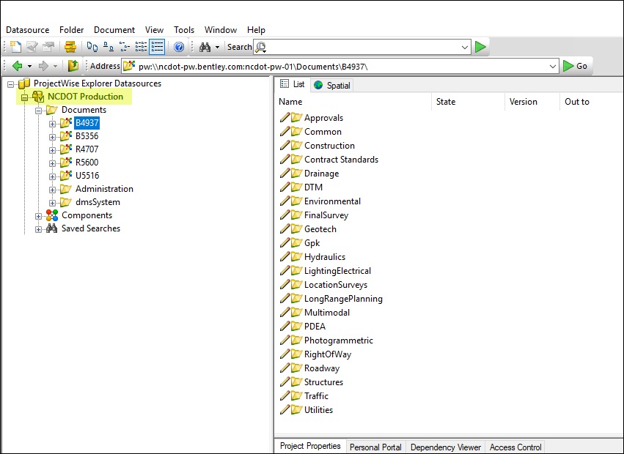
NCDOT ProjectWise Hosted by Bentley

Slide 18
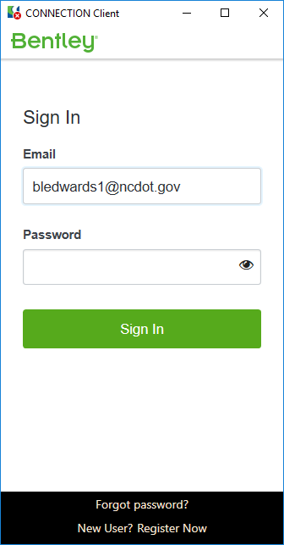
ProjectWise Authentication - Internal
Federated against our Active Directory
Connection Client
Simply enter email address and click tab or enter
ADFS Federation automatically passes Windows AD authentication to Bentley making sign in a breeze!

Slide 19
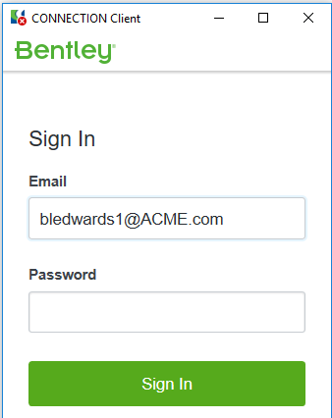
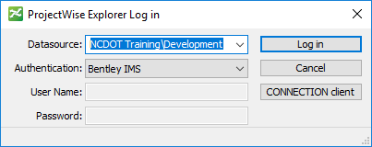

ProjectWise Authentication - External
Bentley IMS
Identity Management System
Identity is checked against the
email domain of your company
(ex. bledwards1@ACME.com)
1
PEF User
Project Access
Write access permission will be established by PW Admin and will be restricted to the Project specific area that PEF is working on
2
Create User Account in ProjectWise
Assign to Group in ProjectWise
NCDOT PW Admin

Slide 20
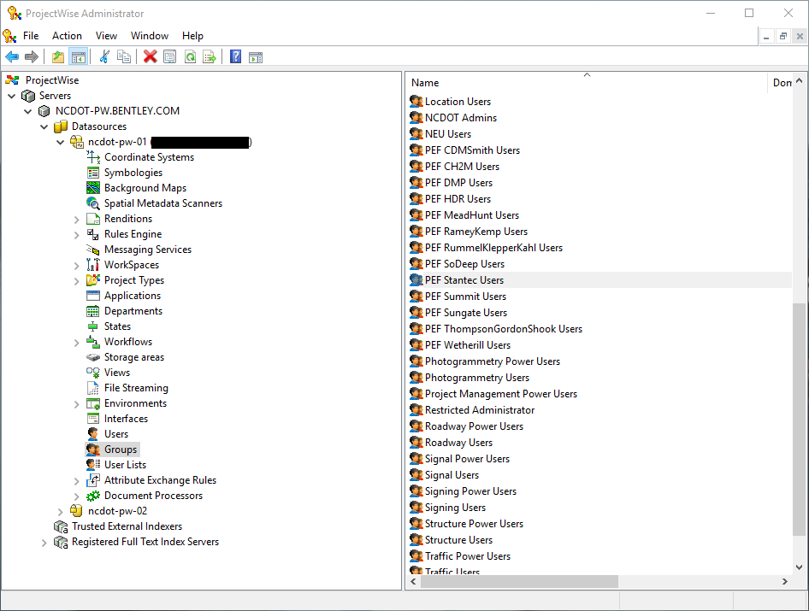
ProjectWise Users/Group
ProjectWise System Admins must create users/groups in ProjectWise in order for them to access ProjectWise
Power Users in Units can manage (add/remove) users from respective groups. (Ex. Mike Kelly can add or remove people from the Hydraulic Users group)
Project Leads can manage PEF Groups access to Projects
PEF Group management – We can authorize representative from PEF to administer users within their respective groups

Slide 21
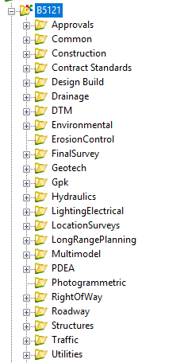
Managed Workspaces (CADD)
Workspaces are built in to ProjectWise
Folder Driven - Any DGN file opened under a Hydraulics folder will open MicroStation in Hydraulics workspace, and so on.
First Time Open – ProjectWise has to download the entire workspace. All subsequent opens pull only workspace deltas
Speed Expectations - Slow on first time open

Slide 22
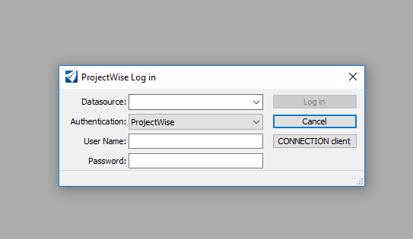
What if I don’t want to go into ProjectWise …

Slide 23
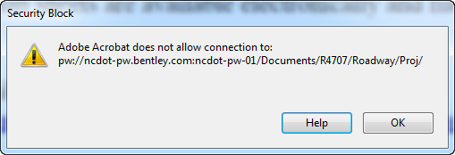
Linking of PDFs from ProjectWise
Example of Link to ProjectWise: pw:\\ncdot-pw.bentley.com:ncdot-pw-01\Documents\R4707\Roadway\Proj\
Adobe Reader Results – WILL NOT work. You are prompted with a message “Adobe Acrobat does not allow connection to…” (shown below) which prevents the user from going to the ProjectWise folder.

Slide 24
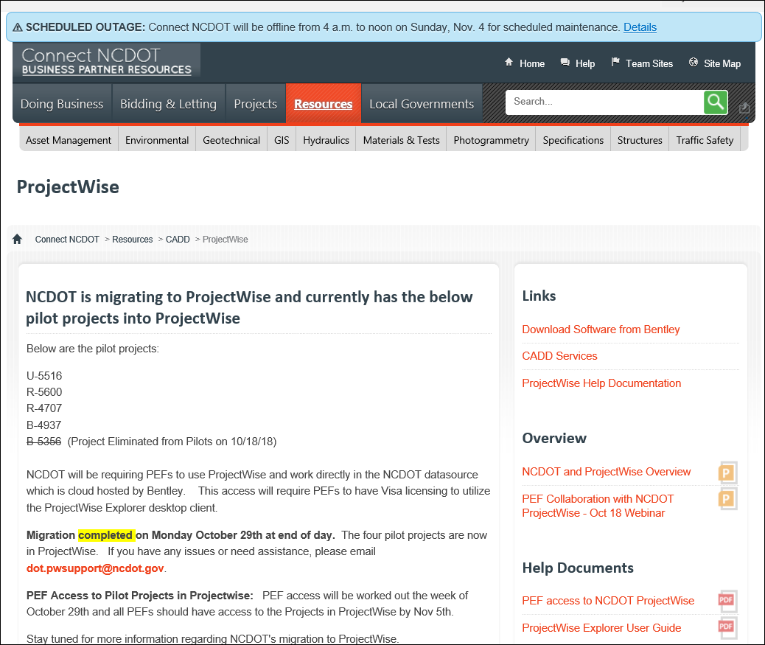
ProjectWise Website
https://connect.ncdot.gov/resources/CADD/Pages/ProjectWise.aspx

Slide 25
What’s Next
SAP Feed / Caching Server
NCDOT
Datasource
Powershell (SAP metadata)
SAP
SharePoint
FTS (SAP metadata)
Caching
Server
Sync Milestone PDFs

Slide 26
NCDOT ProjectWise
If you have issues or questions regarding the pilot projects and ProjectWise, please contact dot.pwsupport@ncdot.gov

Slide 27
NCDOT OpenRoads Designer Update

Slide 28
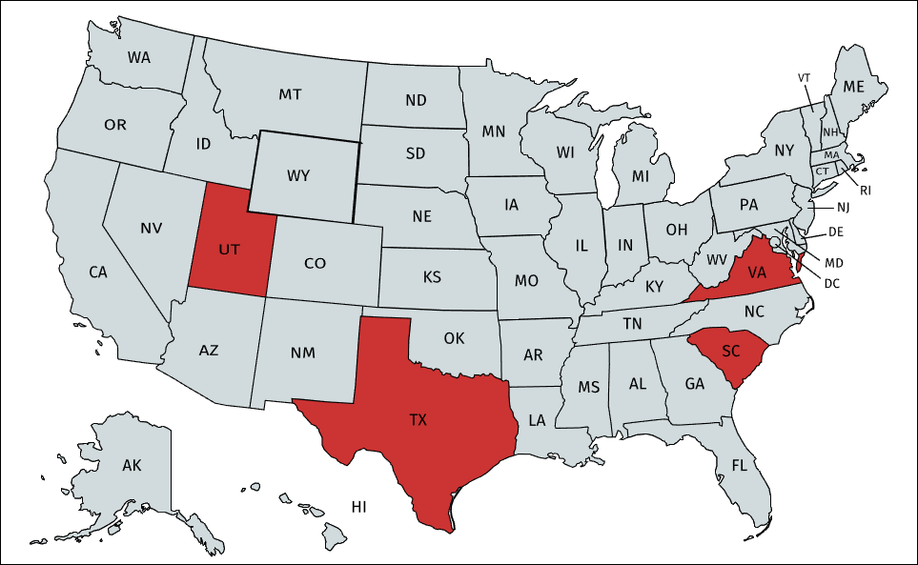
What are other DOTs doing with ORD?
Virginia
Currently on SS4
Targeting end of 2019 for ORD implementation
UTAH
Have already started a small number of Projects in ORD; otherwise 95% still in SS4
South Carolina
Currently on SS4
Targeting 2020 for ORD implementation
Texas
Currently on SS4
Targeting Spring of 2019 for ORD implementation

Slide 29
Why Move to OpenRoads Designer (ORD) ?
OpenRoads Designer is 3d model centric, meaning it is built for creating intelligent 3d models that reflect cutting edge technological trends in transportation design and construction.
OpenRoads Designer will offer increased productivity through advanced model creation that will reduce both design errors and construction costs resulting from design-related changes.
OpenRoads Designer will support the benefits of digital deliverables, including industry trends of AMG (Automated Machine Grading) and eConstruction.

Slide 30

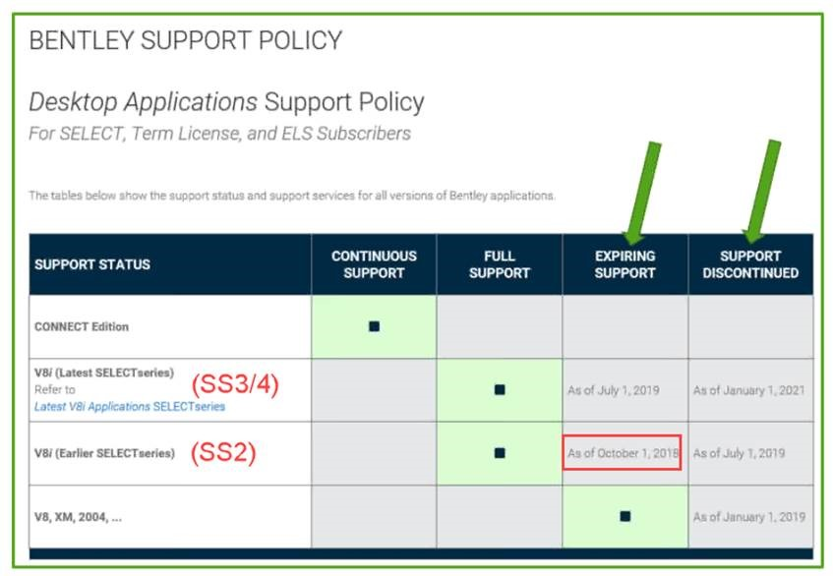

WHY ORD?
Bentley is discontinuing support for all
product lines January 1, 2021 except
CONNECT Edition
V8i (SS2) Support Expires Oct 1, 2018
Support Discontinues July 1, 2019
V8i (SS3/4) Support Expires July 1, 2019
Support Discontinues Jan 1, 2020
Notes:
WHY ORD? Well, besides the positive reasons those videos showed, there’s also a negative reason … there’s a support cliff we’re approaching with our current software. If you go to Bentley’s website you’ll see this Support Policy Chart. Bentley is discontinuing support for all “non-CONNECT Edition” product lines January 1, 2021. And you see the dates there that apply to V8i: SS2, SS3, & SS4. Basically, the “Support Expires” date means you’ve been put on notice, and the “Support Discontinues” date … is when they disconnect the phone line. More generally speaking, what this chart says is, if you’re not looking forward to 3D modeling, you’re looking backwards. As far as Bentley is concerned … is the only option. This is where the industry is headed and where NCDOT is headed. (InRoads, MXROAD, Geopak all gone.) *click*

Slide 31
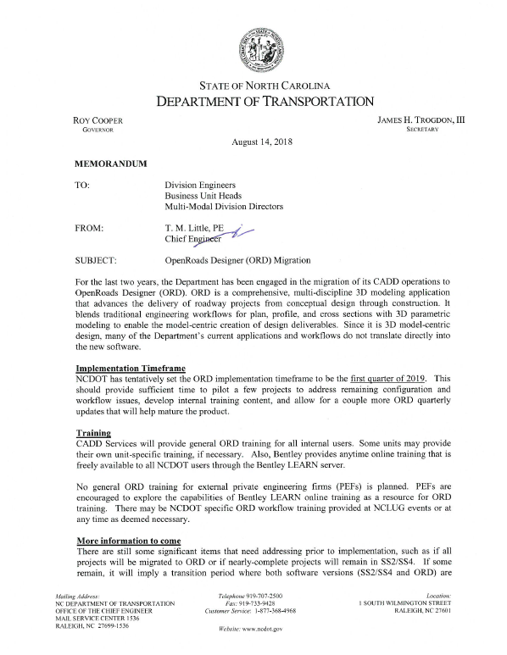
WHEN? … And HOW do we get there?
Chief Little memo sent August 14, 2018
Implementation: Q1-2019
“ORD Pilot Program” (Start … Q4–2018)
    Produce an integrated model PLANS
    Test: Software, workspaces, workflows
    Files managed using ProjectWise
    Will use managed workspaces
    First Wave: Now (~5-10 Projects)
    Second Wave: Jan 2019 (+10-15 Projects)
    Third Wave: TBD
Notes:
So … WHEN? … And HOW do we get there? Hopefully you saw the August 14 memo sent out by Chief Tim Little announcing the department’s intentions to move to ORD. Implementation is tentatively set for the first quarter of next year. I will say, a lot of planets have to align to meet that goal. There are a lot of unknowns yet to be uncovered and changes that will need to take place across several departmental units. To do this, we are closing in on getting an ORD Pilot Program started this month. The main goal with the pilots, will be to produce an integrated model across all disciplines. Which of course in ORD is necessary to create the plans to LET the project. Now doing this will test the software, and our workspaces, but mainly our workflows. It’ll test the “WHY” we produce what we produce … and help begin the discussions of what operations need to be carried forward into a modeling workflow. What we need to STOP, START, or CONTINUE. The thinking currently, is the pilot projects files will be managed through ProjectWise and these projects will use managed workspaces. The first wave will begin this year and involve 5 to 10 projects. The second wave will start next January and will add another 10 to 15 projects. Third wave … to be determined. *click*

Slide 32
HOW do we get there?
ORD Pilot Program
Project Selection
    Project Types: Intersection, Bridge, Widening
    Status: Non-Accelerated, plans just starting
    Schedule: R/W Date >= June 2019
    Some will be “In-House” designed projects
Firm Selection
    Expert level designer/CADD operator attached
    CADD Coordinator / CADD Developer background
    Completed Bentley’s ORD LEARN Server training &
    NCDOT’s “ORD Quickstart Training” through NCLUG
Notes:
A little more information on the pilot program … on Project Selection, as I’m sure you’d agree, you want to set the bar a little low on your first jump, so we’re going with Intersection, Bridge, Widening as our initial project types. They should be “non-accelerated” projects, with plans just starting. On schedule, a R/W date of no earlier than June 2019 should allow time to de-bug any issues that might arise. Some will be “In-House” designed projects. For those that are not “In-House” projects that will be done by Private Engineering Firms, we would expect to see firms with EXPERT level designers & CADD operators attached to the projects. And by “expert level” the preference would be for employees to not just have a strong project portfolio, but to also have a CADD coordinator / CADD developer background. We would expect to see the people involved to have completed Bentley’s ORD LEARN Server training and NCDOT’s “ORD Quickstart Training” that’s been offered through NCLUG. *click*

Slide 33
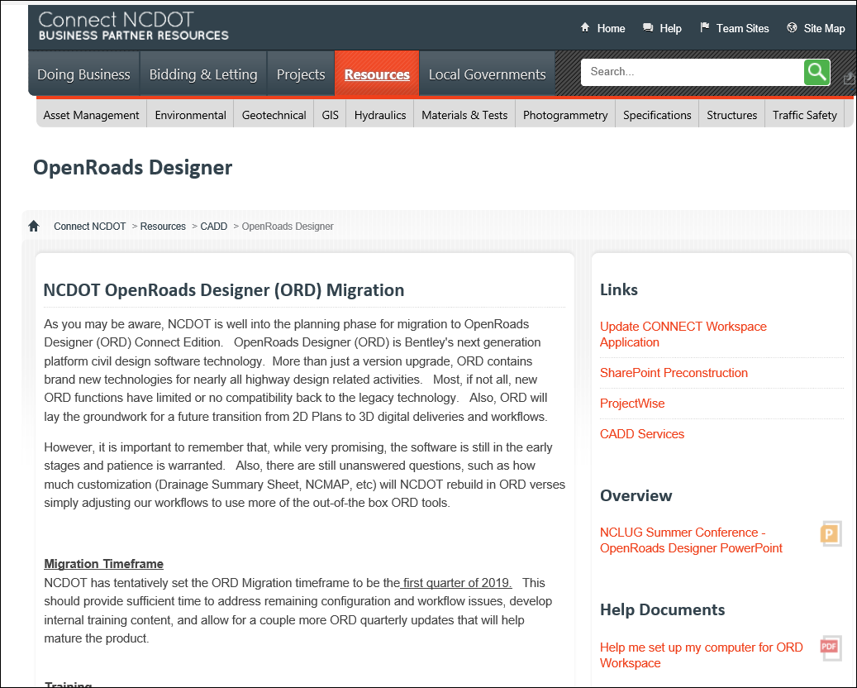
OpenRoads Designer Webpage
https://connect.ncdot.gov/resources/CADD/Pages/OpenRoadsDesigner.aspx

Slide 34

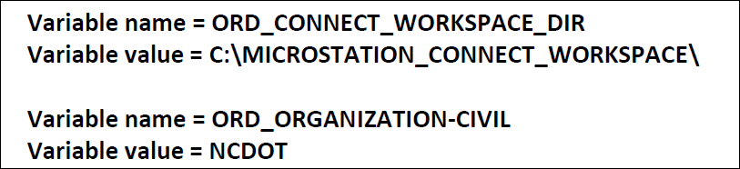
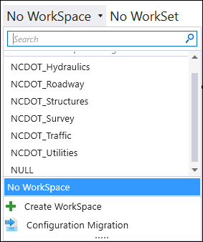
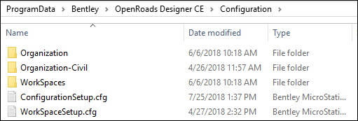
Configuration for NCDOT
1
Copy the WorkspaceSetup.cfg to the C:\ProgramData\Bentley\OpenRoads Designer CE\Configuration folder. Replace the file that is currently in this folder
2

Slide 35
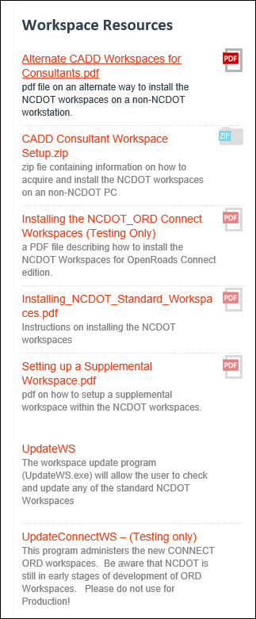



Accommodating Other Agency Standards
NCDOT
VDOT
How could consultant setup work?
The ORD_Organization-Civil environment variable acts as a switch and can be defined for other agency standards if desired.

Slide 36

Accommodating Other Agency Standards
VDOT
NCDOT
VDOT
How could consultant setup work?
The ORD_Organization-Civil environment variable acts as a switch and can be defined for other agency standards if desired.

Slide 37

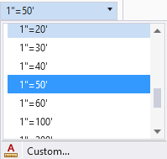
New Scaling Method
Legacy
OpenRoads
Vs
Ratio (50:1)
Multiplication factor: 50x
Scale = (50 x 12)
Multiplication factor : 600x
For ORD Workspace, all Cells and linestyles that are scalable must be reduced by a factor of 12

Slide 38
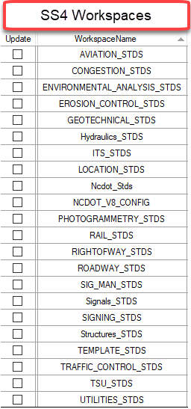
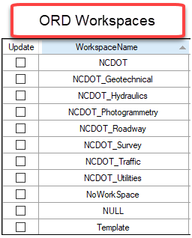
Combining of Traffic Workspaces

Slide 39
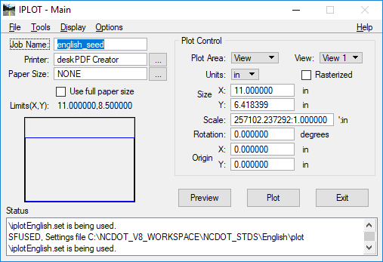
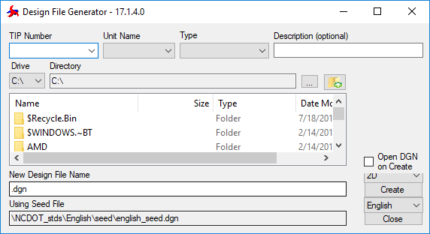
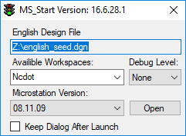
The End of some things …
MS_Start
Iplot
Design File Generator
1
2
3
Replaced with Print/Plot
Replaced by ProjectWise

Slide 40
OpenRoads Designer
Performance/Speed issues
Memory intensive
Some SUDA processing seems very slow
Our going forward CADD equipment:
  I7-6700 Processor
  32 GB DDR4
  Solid State Drives
Release Schedule
Quarterly Updates from Bentley
2018 Release 3 (October)
2019 Release 1 (January)
10.05.00.30

Slide 41
NCDOT Implementation Plan Details
Pilot projects
Integrated with ProjectWise
March 2019 Implementation
  Tentative – Highly dependent upon Piloting
Transition Period (Dual Versions)
  How long ?
  Windows 7 support ends January 2020
  SS2 on Windows 10
Training
  Bentley LEARN

Slide 42
NCDOT ProjectWise
Thank You!

